Slide 1
Higher Maths
Main Menu
Past Papers
by Topics
Past Papers
by Years
Summary Notes
2018 Earlston High School

Slide 2
Topic Menu
Straight Lines
Quadratics
Polynomials
Differentiation 1
Differentiation 2
Integration 1
Integration 2
Trigonometry
Wave Function
Vectors 1
Vectors 2
Functions & Graphs
Exponentials & Logarithms
Circles
Recurrence Relations
Notes Menu
Main Menu

Slide 3
Past Papers
All papers property of the SQA
2013
Paper 1
(Includes Multiple Choice)
2014
Paper 1
(Includes Multiple Choice)
Specimen Paper 1
Exemplar Paper 1
2013
Paper 2
2014
Paper 2
Specimen Paper 2
Exemplar
Paper 2
2015
Paper 1
2016
Paper 1
2017
Paper 1
2018
Paper 1
2015
Paper 2
2016
Paper 2
2017
Paper 2
2018
Paper 2
Additional Questions
Topic Menu
Notes Menu
Main Menu

Slide 4
Summary Notes
Notes ©HSN.uk.net with additions.
https://creativecommons.org/licenses/by-nc-sa/2.5/scotland/
Straight Lines
Quadratics
Polynomials
Differentiation 1
Differentiation 2
Integration 1
Integration 2
Trigonometry
Wave Function
Vectors 1
Vectors 2
Exponentials & Logarithms
Functions & Graphs
Exponentials & Logarithms
Circles
Recurrence Relations
Topic Menu
Main Menu

Slide 5
Straight Line
Parallel & Perpendicular Lines
2016 P1
Q1
2013 P1
Q5
Spec P1
Q5
2017 P1
Q11
Collinearity in 2D
Angle & Gradient
2017 P2
Q10a
2015 P1
Q9
2018 P1
Q8
2017 P2
Q1b
Intersections of Lines
Spec P2
Q5a
Spec P1
Q9
2018 P1
Q1
2017 P1
Q7
2018 P2
Q5ab
2014 P2
Q1
2015 P2
Q1
2016 P2
Q1
2017 P2
Q1
2013 P2
Q2
Exem P1
Q6
Topic Menu
Notes
Main Menu

Slide 6
Quadratics
Discriminant
2013 P1
Q3
2014 P2
Q3b
2017 P1
Q4
2016 P2
Q2
Exem P2
Q3
Spec P1
Q4
Completing the Square
2017 P2
Q4a
2013 P1
Q21
2014 P1
Q17
2018 P2
Q4
2016 P1
Q12b
2015 P2 Q2b
Spec P1
Q8bc
Quadratic Inequations
2017 P2
Q8b
2015 P1
Q8
2013 P1
Q19
2018 P2
Q10
Topic Menu
Notes
Main Menu

Slide 7
Polynomials
Synthetic Division
2013 P1
Q6
2018 P2
Q7a
2015 P1
Q3
Spec P1
Q7
2017 P2
Q2
2016 P2
Q3a
2013 P2
Q3a
2014 P1
Q22
Exem P1
Q5
Exem P1
Q5
Determining the Equation of the Curve
2014 P1 Q15
Exem P1
Q2
2013 P1
Q17
2016 P1
Q15
Spec P2
Q3a
Intersections of Lines and Curves
Spec P1
Q2
2010 P1 Q22
Curve Sketching
2018 P1
Q15
Topic Menu
Notes
Main Menu

Slide 8
Differentiation 1
Basic Differentiation & Rate of Change
2016 P1 Q2
2017 P1
Q8
2015 P1
Q7
Chain Rule
2017 P1
Q3
2014 P1
Q8
2018 P1
Q3
2013 P1
Q18
Spec P1
Q10
Tangents to Curves
Exem P1
Q1
2015 P1
Q2
2014 P2
Q2
Spec P2
Q3
2018 P1
Q7
Graphs of the Derivative
2008 Spec P2
Q5
2012 P2 Q4
Spec P1
Q11b
Topic Menu
Notes
Main Menu

Slide 9
Differentiation 2
Increasing and Decreasing Functions
2018 P2
Q3
Spec P1
Q11a
2017 P2
Q4bc
2016 P1
Q9b
Stationary Points
2013 P2
Q3b
2016 P1
Q9a
2014 P1
Q21
2017 P2 Q7
Optimisation
2018 P2
Q9
2016 P2
Q7
2013 P2
Q7
Spec P2
Q8
2015 P2
Q8
Topic Menu
Notes
Main Menu

Slide 10
Integration 1
Basic Integration
2013 P1
Q7
Exem P1
Q3
Spec P1
Q1
Differential Equations
2018 P1 Q10
Exem P1 Q10
2016 P2
Q9
2015 P1
Q15
Chain Rule
2014 P1
Q5
2013 P1
Q16
2016 P1
Q5
2017 P1
Q13
2018 P1
Q14
2014 P2
Q5
2013 P2
Q6
Exem P2
Q8
2016 P2
Q10
2015 P2
Q7ac
Topic Menu
Notes
Main Menu

Slide 11
Integration 2
Area
2018 P2
Q1
2016 P2
Q3
2015 P1
Q12
2013 P2
Q4
2014 P2
Q7
Spec P2
Q9
2015 P2
Q4
2017 P1
Q10
Equations of Motion
2014 P2
Q9
2002 P2
Q8
Topic Menu
Notes
Main Menu

Slide 12
Trigonometry
Basic Trigonometry & Graphs
2015 P1
Q4
2013 P1
Q4
2014 P1
Q13
2013 P1
Q15
Addition Formulae
2013 P1
Q10
Spec P1
Q6
2016 P1
Q13
Double Angle Formulae
2014 P1
Q7
2013 P1
Q9
2015 P1
Q10
2018 P1
Q13
2015 P2
Q7b
##
Q
2014 P1
Q18
2013 P2
Q8
2017 P2
Q6
2014 P2
Q6
2018 P2
Q6b
Exem P1
Q7
Further Trig Equations
2016 P2
Q11
2017 P2
Q11
Topic Menu
Notes
Main Menu

Slide 13
Wave Function
Wave Function
2014 P1
Q4
2014 P1
Q9
Exem P1
Q9
2016 P2
Q8
2015 P2
Q9
Spec P2
Q10
2018 P2
Q8
2013 P1
Q23
2017 P1
Q14
Topic Menu
Notes
Main Menu

Slide 14
Vectors 1
Basic Questions
2014 P1
Q6
2014 P1
Q19
2018 P1
Q9
2013 P1
Q12
2016 P1
Q7
2018 P1
Q12
Collinearity in 3D and Dividing a Line in a Ratio
2018 P1
Q5
2013 P1
Q24a
2009 P1
Q22a
2016 P1
Q11
Topic Menu
Notes
Main Menu

Slide 15
Vectors 2
Perpendicular Vectors
2015 P1
Q1
2014 P1
Q14
Spec P2
Q6
2013 P1
Q24b
Angles Between Vectors
2018 P2
Q2
2016 P2
Q5
2014 P2
Q4
Spec P2
Q1
##
Q
Exem P2
Q5
2017 P2
Q5
Scalar Product and Vector Calculus
2013 P1
Q14
Exem P2
Q6
2014 P1
Q16
##
Q
2017 P1
Q5
2015 P2
Q6
Topic Menu
Notes
Main Menu

Slide 16
Functions & Graphs
Composite Functions
2013 P1
Q1
2017 P1
Q1
2018 P2
Q6a
2015 P2
Q2a
2014 P2
Q3a
Spec P1
Q8a
Exem P1
Q11a
Restrictions on Domain/Range
2016 P1
Q12a
2013 P1
Q13
2014 P1
Q12
2015 P2
Q2c
Inverse Functions and their Graphs
2018 P1
Q2
2015 P1
Q5
2016 P1
Q6
2017 P1
Q6
Exem P1
Q11b
2015 P1
Q13b
2016 P1
Q10
Graph Transformations
2013 P1
Q11
2014 P1
Q11
Spec P1 Q8d
##
Q
Exem P1
Q8a
2015 P1
Q13c
2017 P1
Q15
Topic Menu
Notes
Main Menu

Slide 17
Exponentials & Logs
Exponential Relationships
2016 P2
Q6
Spec P2
Q7
2018 P2
Q11
Exem P2
Q7
Applying Log Rules
2017 P1
Q12
2014 P1
Q20
##
Q
2015 P1
Q6
2018 P1
Q6
2014 P1
Q3
2016 P1
Q14
2013 P2
Q5
2018 P1
Q11
Log and Exponential Graphs
2013 P1
Q20
2014 P1
Q24
2017 P2
Q9
Spec P2
Q4
Topic Menu
Notes
Main Menu

Slide 18
Circles
Finding the Equation of a Circle
2018 P2
Q5c
2016 P1
Q4
Spec P2
Q5b
2017 P2
Q10
2015 P2
Q5
Tangent to a Circle
2014 P1
Q2
2018 P1
Q4
2017 P1
Q2
2016 P1
Q8
2015 P1
Q11
Intersection of a Line and a Circle
Centre, Radius and Intersection
2017 P2
Q3
2015 P1
Q14
2016 P2
Q4
2014 P2 Q8
Mixed Questions
Exem P2
Q2
2014 P1
Q23
2018 P2
Q12
2013 P1
Q22
Topic Menu
Notes
Main Menu

Slide 19
Recurrence Relations
Finding Terms
2014 P1
Q1
2017 P2
Q8a
2018 P2
Q7b
Calculate the Limit
2014 P1
Q10
2016 P1
Q3
2015 P2
Q3
2018 P2
Q7c
Finding a Recurrence Relation (see also “Mixed Questions”)
2013 P2
Q1
Mixed Questions
2013 P1
Q8
2017 P1
Q9
Exem P2
Q1
Spec P2
Q2
Topic Menu
Notes
Main Menu

Slide 20
Quadratics
Page 1 of 3
The Discriminant
Next Page
Topic Menu
Notes
Menu
Main Menu

Slide 21
Quadratics
Page 2 of 3
Completing the Square
Previous
Next Page
Topic Menu
Notes
Menu
Main Menu

Slide 22
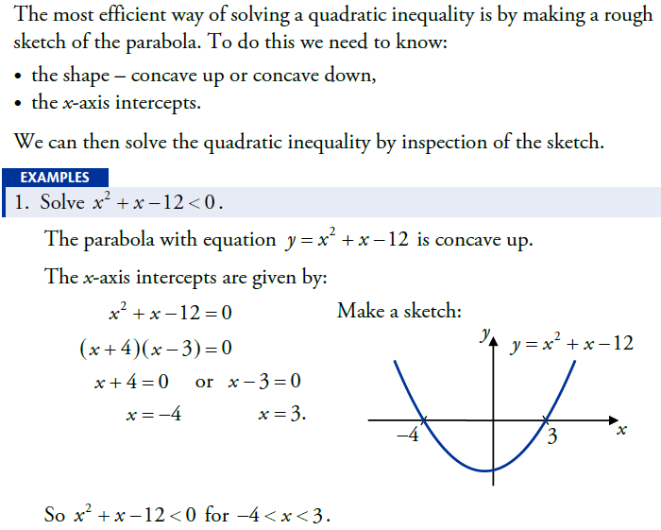
Quadratics
Page 3 of 3
Quadratic Inequations
Previous
Topic Menu
Notes
Menu
Main Menu

Slide 23
Polynomials
Page 1 of 3
Synthetic Division
Next Page
Topic Menu
Notes
Menu
Main Menu

Slide 24
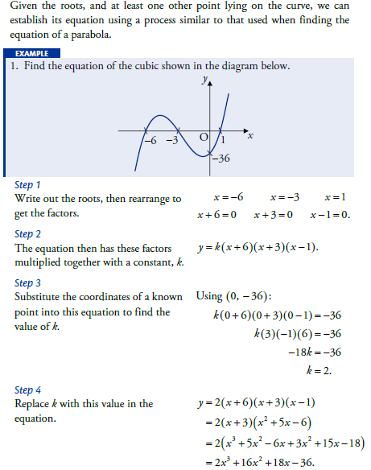
Polynomials
Page 2 of 3
Finding the Equation of a Curve
Previous
Often one of the roots will be a repeated root because a turning point lies on the
x-axis.
e.g. If there is a turning point at (3, 0)
then (x – 3)² is a factor.
Next Page
Topic Menu
Notes
Menu
Main Menu

Slide 25
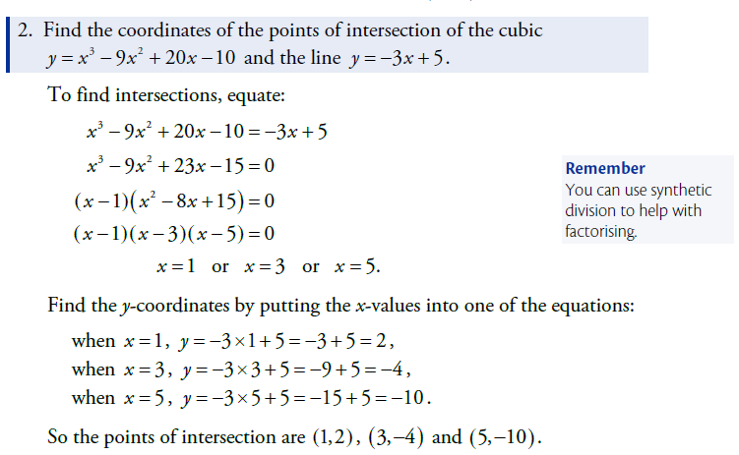
Polynomials
Page 3 of 3
Intersection of Lines and Curves
Previous
Topic Menu
Notes
Menu
Main Menu

Slide 26
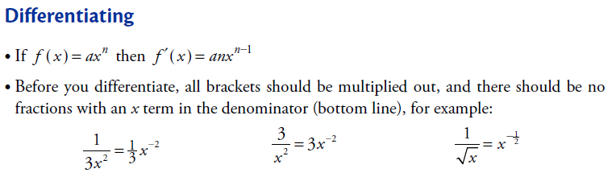
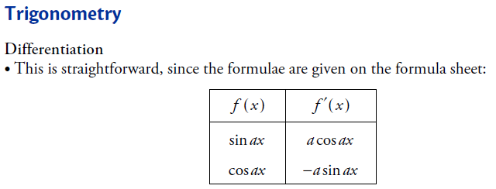
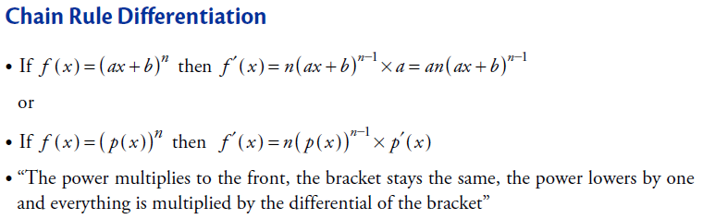
Differentiation 1
Page 1 of 4
Rules
Next Page
Topic Menu
Notes
Menu
Main Menu

Slide 27
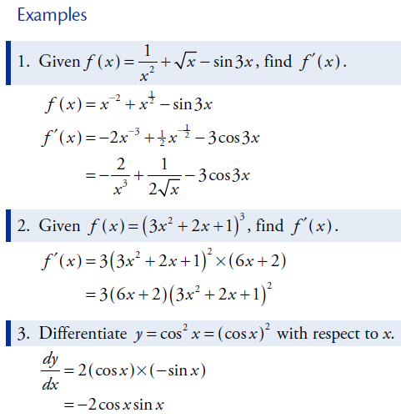
Differentiation 1
Page 2 of 4
Examples
Previous
Next Page
Topic Menu
Notes
Menu
Main Menu

Slide 28
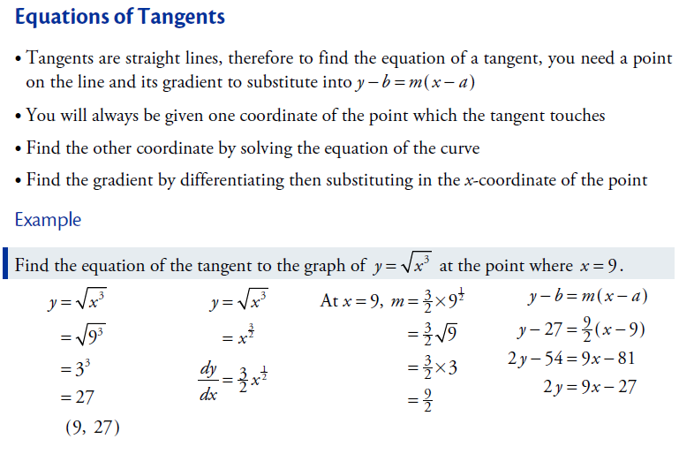
Differentiation 1
Page 3 of 4
Tangents
Previous
Next Page
Topic Menu
Notes
Menu
Main Menu

Slide 29
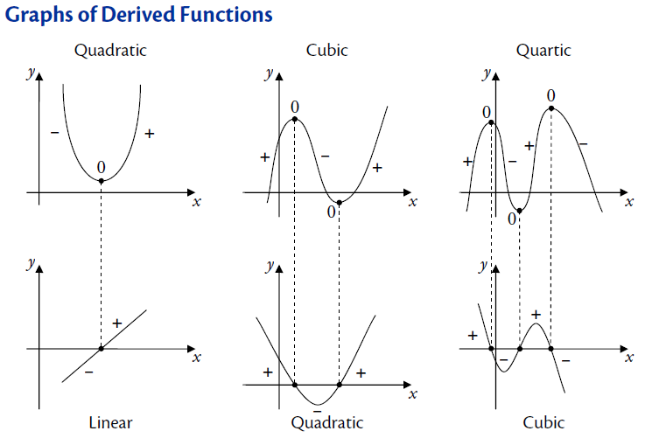
Differentiation 1
Page 4 of 4
Graphs of the Derivative
Previous
Topic Menu
Notes
Menu
Main Menu

Slide 30
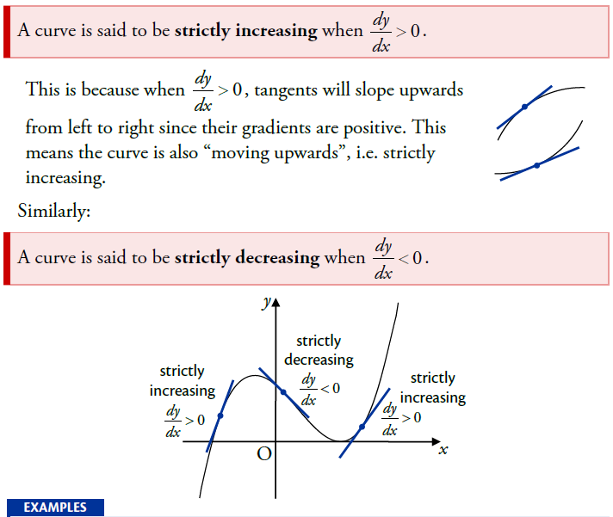
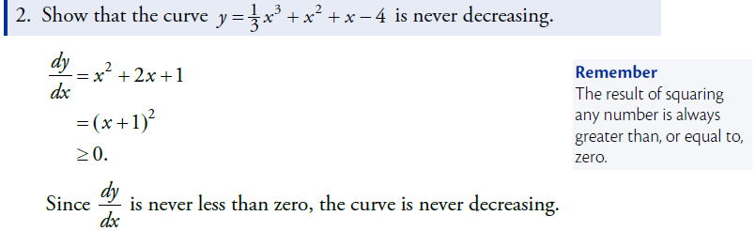
Differentiation 2
Page 1 of 2
Increasing and Decreasing Functions
Next Page
Topic Menu
Notes
Menu
Main Menu

Slide 31
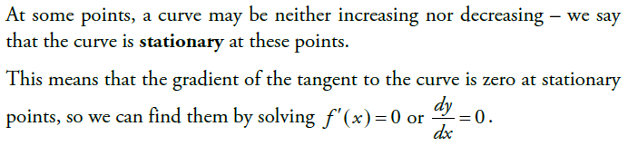
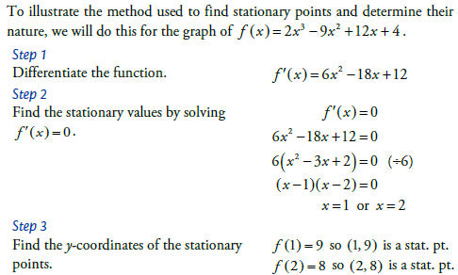
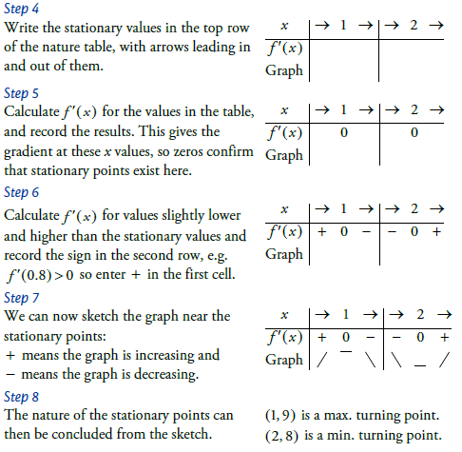
Differentiation 2
Page 2 of 2
Stationary Points & Optimisation
Previous
Topic Menu
Notes
Menu
Optimisation questions are usually practical problems which involve finding a maximum or minimum value, area or volume.
You must show that the value you have found is a maximum or minimum (use a nature table).
If there is a closed interval you should also evaluate the end points as these could be higher or lower than a stationary point.
Main Menu

Slide 32
Integration 1
Page 1 of 2
Basic Integration
Next Page
Topic Menu
Notes
Menu
Main Menu

Slide 33
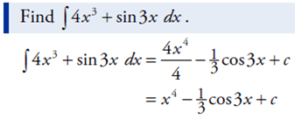
Integration 1
Page 2 of 2
Trig Functions and Chain Rule
Previous
Topic Menu
Notes
Menu
Main Menu

Slide 34
Integration 2
Page 1 of 1
Area
Topic Menu
Notes
Menu
Main Menu

Slide 35
Trigonometry
Page 1 of 5
Basic Skills
Next Page
Topic Menu
Notes
Menu
Main Menu

Slide 36
Trigonometry
Page 2 of 5
Basic Skills (Example 1)
Previous
Next Page
Topic Menu
Notes
Menu
Main Menu

Slide 37
Trigonometry
Page 3 of 5
Basic Skills (Example 2)
Previous
Next Page
Topic Menu
Notes
Menu
Main Menu

Slide 38
Trigonometry
Page 4 of 5
Trig Graphs
Previous
Next Page
Topic Menu
Notes
Menu
Main Menu

Slide 39
Trigonometry
Page 5 of 5
Angle Formulae
Previous
Topic Menu
Notes
Menu
Main Menu

Slide 40
Wave Function
Page 1 of 2
Wave Functions 1
Next Page
Topic Menu
Notes
Menu
Main Menu

Slide 41
Wave Function
Page 2 of 2
Wave Functions 2
Previous
Topic Menu
Notes
Menu
Main Menu

Slide 42
Vectors 1
Page 1 of 2
Basic Facts
Next Page
Topic Menu
Notes
Menu
Main Menu

Slide 43
Vectors 1
Page 2 of 2
Dividing in a Ratio
Previous
Topic Menu
Notes
Menu
Main Menu

Slide 44
Vectors 2
Page 1 of 4
Scalar Product
Previous
Next Page
Topic Menu
Notes
Menu
Main Menu

Slide 45
Vectors 2
Page 2 of 4
Scalar Product Example
Previous
Next Page
Topic Menu
Notes
Menu
Main Menu

Slide 46
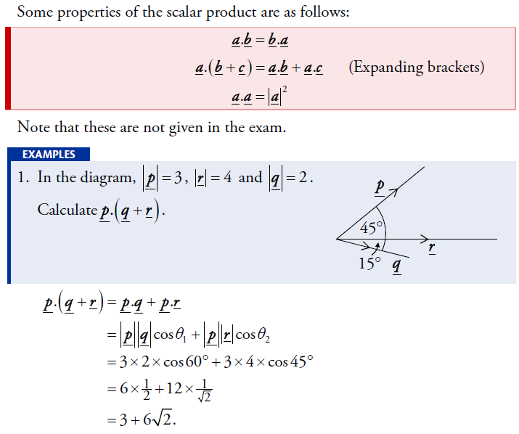
Vectors 2
Page 3 of 4
Vector Calculus
Previous
Next Page
Topic Menu
Notes
Menu
Main Menu

Slide 47
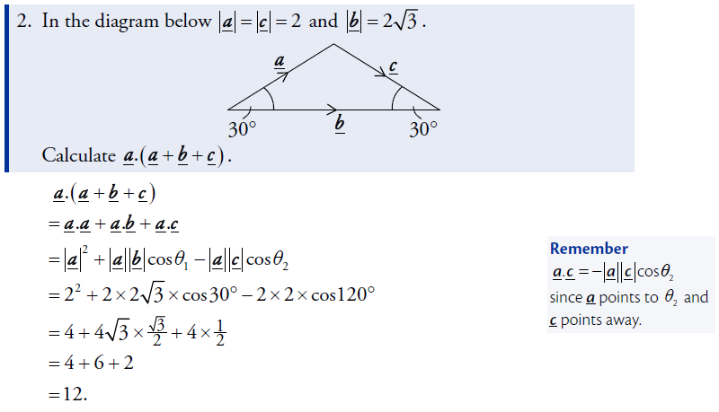
Vectors 2
Page 4 of 4
Vector Calculus
Previous
Topic Menu
Notes
Menu
Main Menu

Slide 48
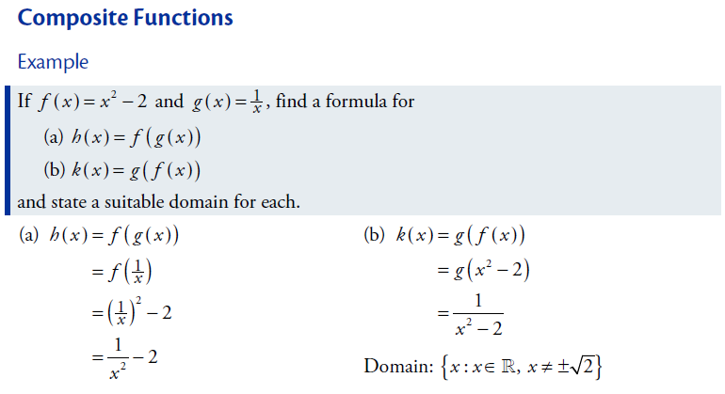
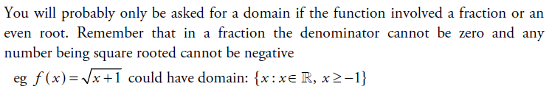

Functions & Graphs
Page 1 of 5
Composite Functions & Domain
Next Page
Topic Menu
Notes
Menu
Main Menu
In the examples above, (a) has domain $x≠0$;
(b) has domain $x^{2}≠2$ so $x≠±\sqrt{2}$

Slide 49
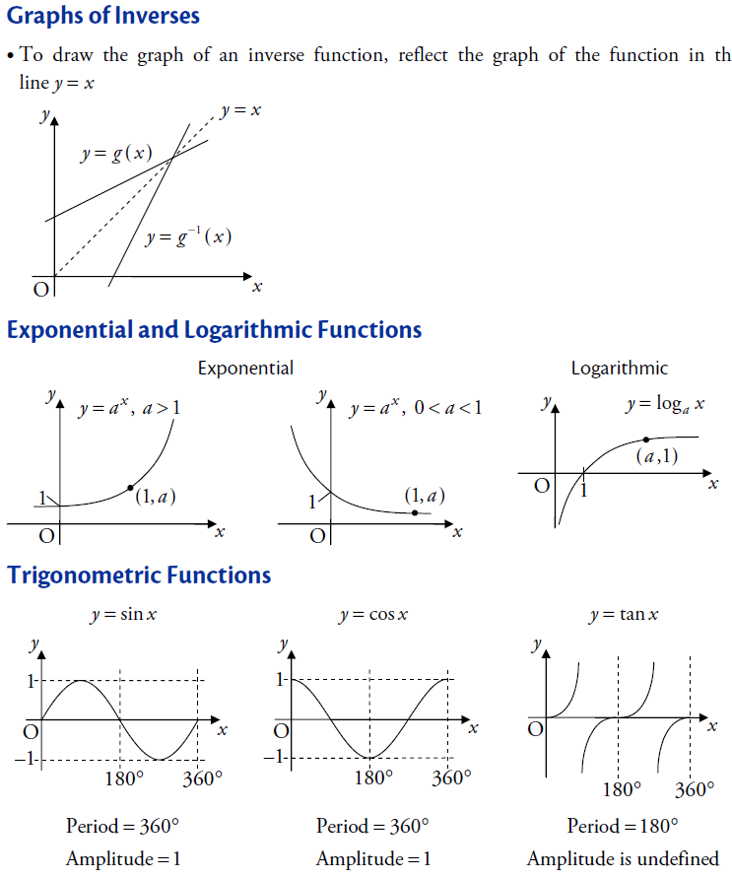
Functions & Graphs
Page 2 of 5
Types of Graph
Previous
Next Page
Topic Menu
Notes
Menu
Main Menu

Slide 50
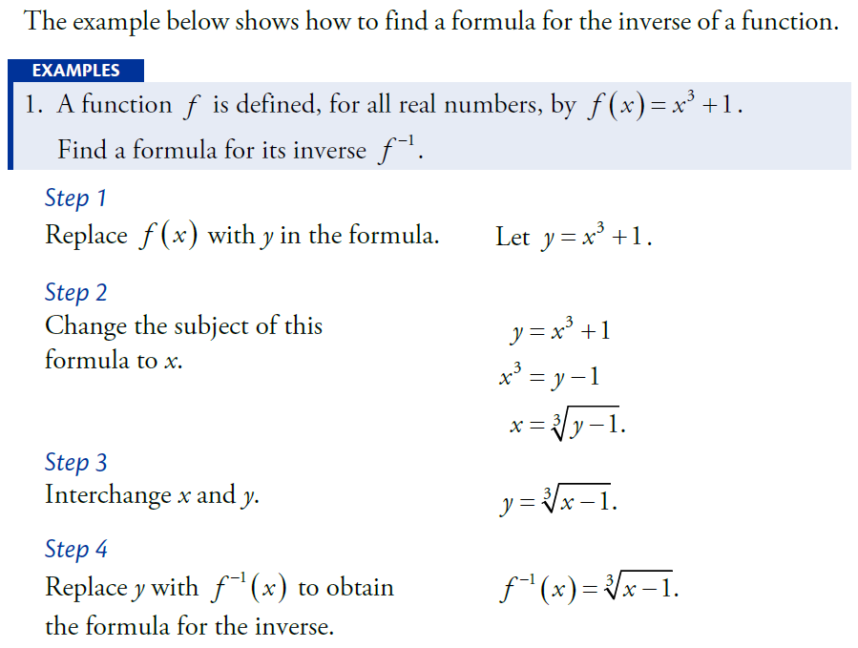
Functions & Graphs
Page 3 of 5
Finding an Inverse Function
Previous
Next Page
Topic Menu
Notes
Menu
Main Menu

Slide 51
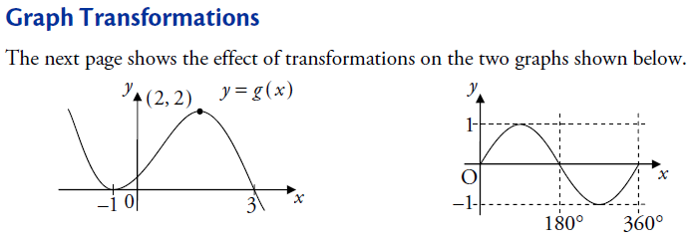
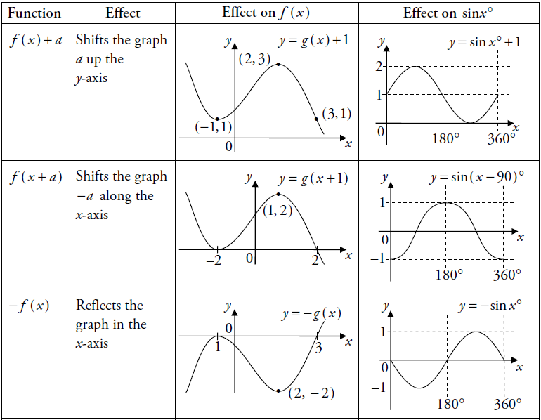
Functions & Graphs
Page 4 of 5
Transformations 1
The next table
Previous
Next Page
Topic Menu
Notes
Menu
Main Menu

Slide 52
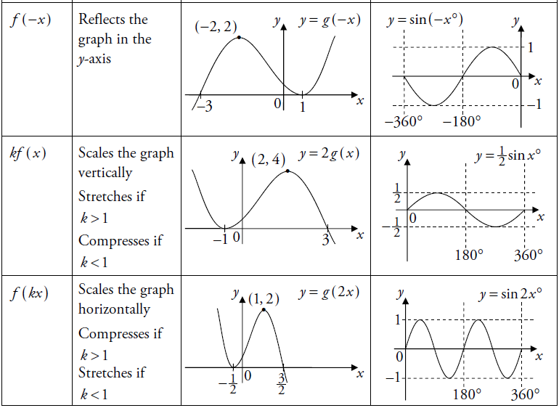
Functions & Graphs
Page 5 of 5
Transformations 2
The next table
Previous
Topic Menu
Notes
Menu
Main Menu

Slide 53
Exponentials & Logarithms
Page 1 of 3
Basic Rules
Next Page
Topic Menu
Notes
Menu
Main Menu

Slide 54
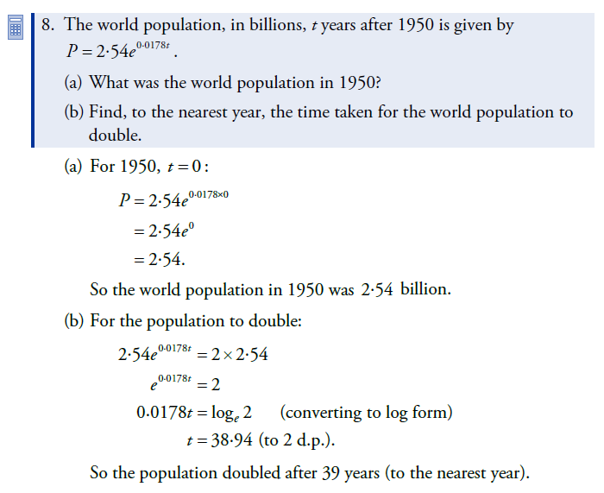
Exponentials & Logarithms
Page 2 of 3
Exponential Example
Previous
Next Page
Topic Menu
Notes
Menu
Main Menu

Slide 55
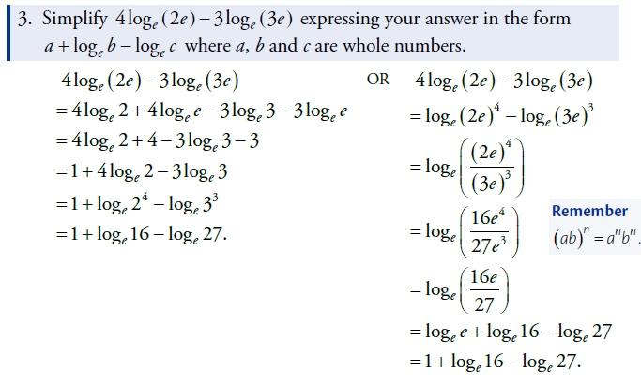
Exponentials & Logarithms
Page 3 of 3
Log Examples
Previous
Topic Menu
Notes
Menu
Main Menu

Slide 56
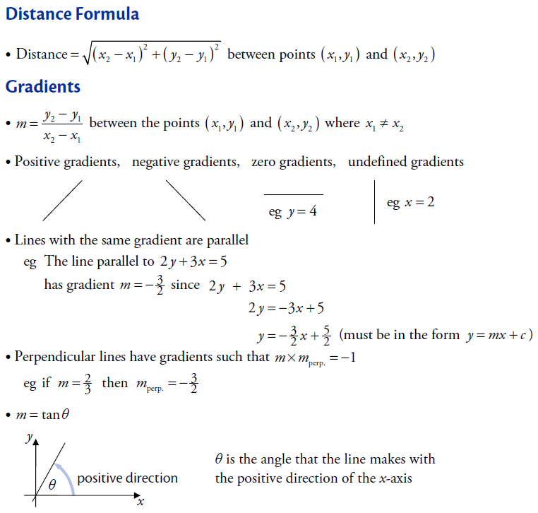
Straight Lines
Page 1 of 2
Distance & Gradient
Next Page
Topic Menu
Notes
Menu
Main Menu

Slide 57
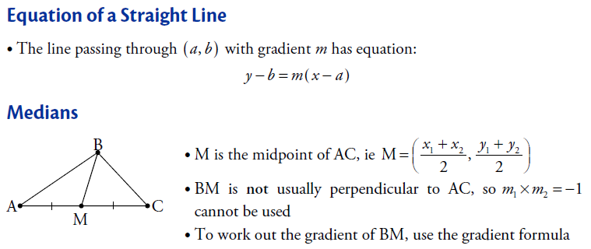
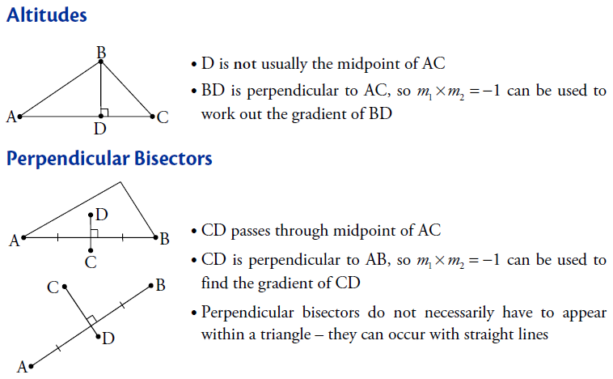
Straight Lines
Page 2 of 2
Lines
Previous
Topic Menu
Notes
Menu
Main Menu

Slide 58
Circles
Page 1 of 1
Circles
Topic Menu
Notes
Menu
Main Menu

Slide 59
Recurrence Relations
Page 1 of 1
Recurrence Relations
Topic Menu
Notes
Menu
Main Menu

Slide 60

2013 P1 Title
2013
Paper 1 Section A (Multiple Choice)
Q1
Q2
Q3
Q4
Q5
Q6
Q7
Q8
Q9
Q10
Q11
Q12
Q13
Q14
Q15
Q16
Q17
Q18
Q19
Q20
Next Slide
Paper 1 Section B
Q21
Q22
Q23
Q24
Main Menu

Slide 61
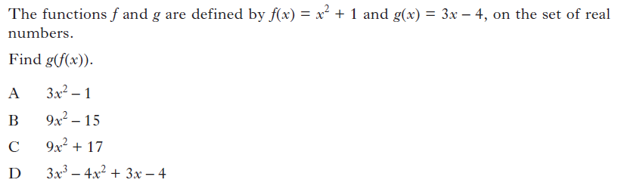
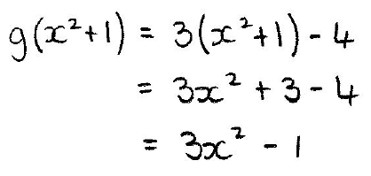
2013 P1 Q1
Topic Menu
Next Slide
Main Menu

Slide 62
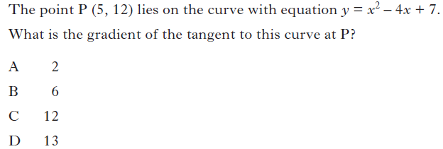
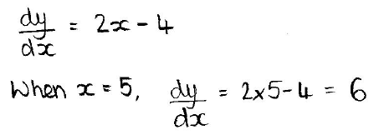
2013 P1 Q2
Topic Menu
Next Slide
Main Menu

Slide 63
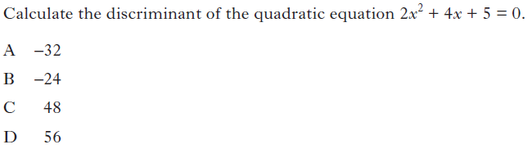
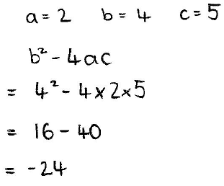
2013 P1 Q3
Topic Menu
Next Slide
Main Menu

Slide 64
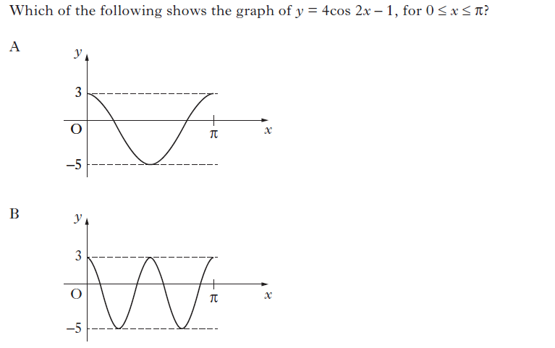
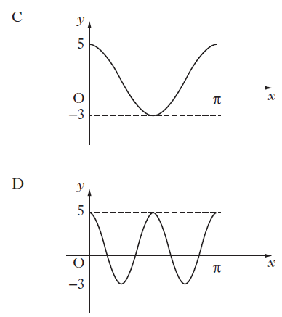
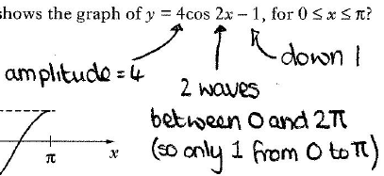
2013 P1 Q4
Topic Menu
Next Slide
Main Menu

Slide 65
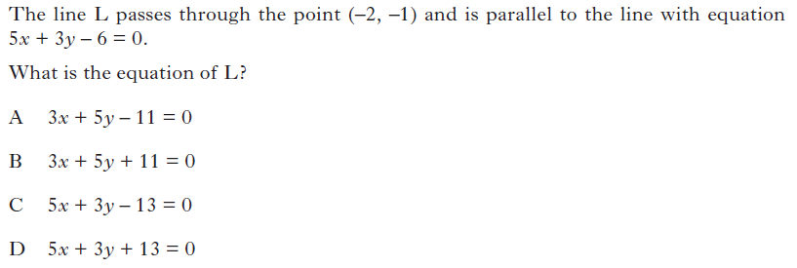
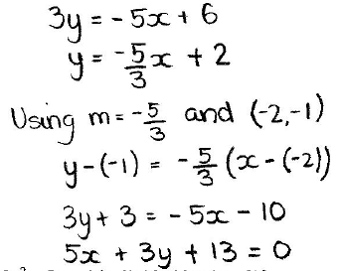
2013 P1 Q5
Topic Menu
Next Slide
Main Menu

Slide 66
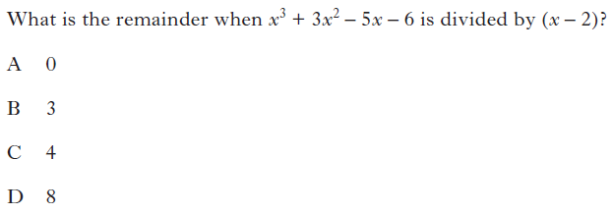
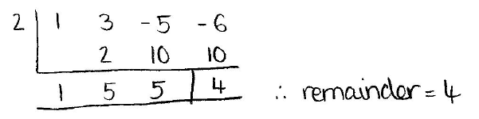
2013 P1 Q6
Topic Menu
Next Slide
Main Menu

Slide 67
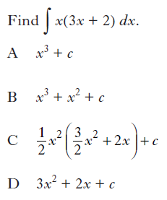
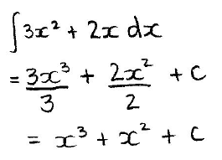
2013 P1 Q7
Topic Menu
Next Slide
Main Menu

Slide 68
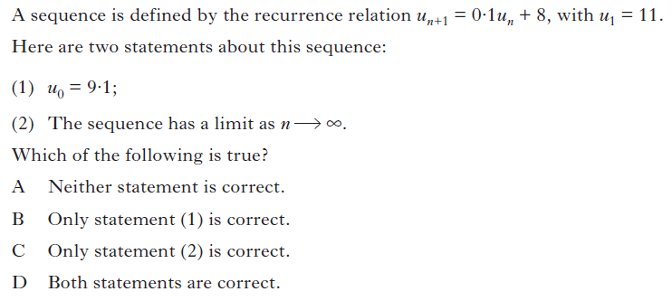




2013 P1 Q8
Topic Menu
Next Slide
Main Menu

Slide 69
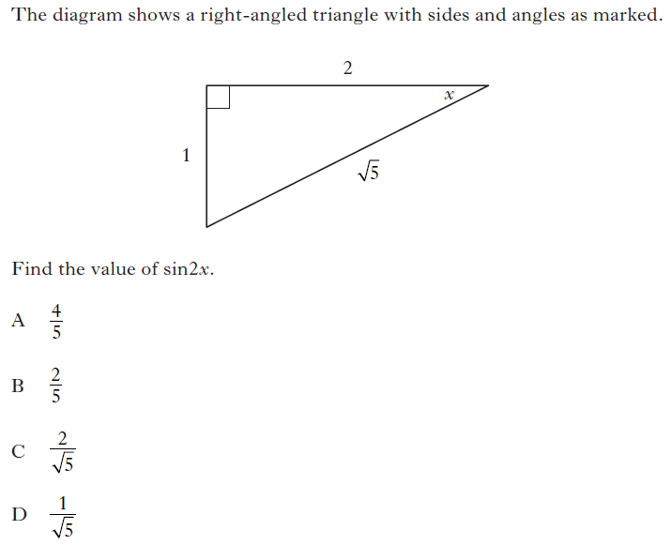
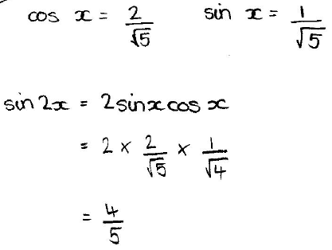
2013 P1 Q9
Topic Menu
Next Slide
Main Menu

Slide 70
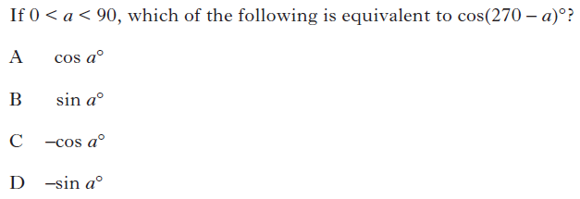
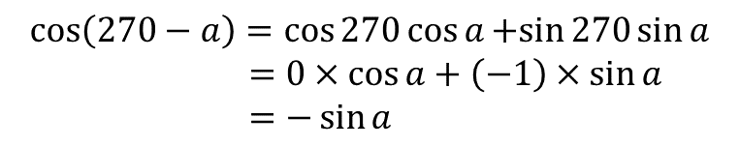
2013 P1 Q10
$$\cos\left(270−a\right)=\cos{270}\cos{a}+sin{270}\sin{a}$$
$=0×\cos{a}+\left(−1\right)×\sin{a}$
$=−\sin{a}$
Topic Menu
Next Slide
Main Menu

Slide 71
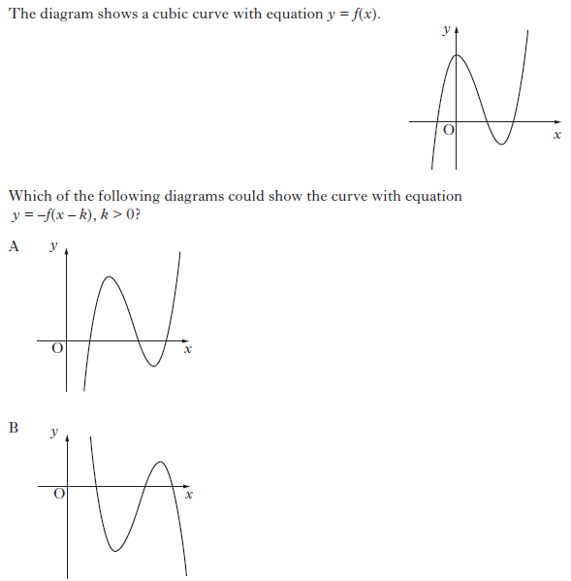


2013 P1 Q11
Next Slide
Topic Menu
Main Menu

Slide 72


2013 P1 Q12
Topic Menu
Next Slide
Main Menu

Slide 73


2013 P1 Q13
Topic Menu
Next Slide
Main Menu

Slide 74


2013 P1 Q14
Topic Menu
Next Slide
Main Menu

Slide 75


2013 P1 Q15
Topic Menu
Next Slide
Main Menu

Slide 76


2013 P1 Q16
Topic Menu
Next Slide
Main Menu

Slide 77


2013 P1 Q17
Topic Menu
Next Slide
Main Menu

Slide 78


2013 P1 Q18
Topic Menu
Next Slide
Main Menu

Slide 79


2013 P1 Q19
Topic Menu
Next Slide
Main Menu

Slide 80


2013 P1 Q20
Topic Menu
Next Slide
Main Menu

Slide 81

2013 P1 Q21
Topic Menu
Next Slide
Main Menu

Slide 82


2013 P1 Q22
Topic Menu
Next Slide
Main Menu

Slide 83



2013 P1 Q22 (2)
Topic Menu
Next Slide
Main Menu

Slide 84



2013 P1 Q23
Topic Menu
Next Slide
Main Menu

Slide 85



2013 P1 Q24
Topic Menu
Next Slide
Main Menu

Slide 86

2013 P2 Title
2013
Paper 2
Q1
Q2
Q3
Q4
Q5
Q6
Q7
Q8
Q9
Next Slide
Main Menu

Slide 87
2013 P2 Q1
Topic Menu
Next Slide
Main Menu

Slide 88
2013 P2 Q2
Topic Menu
Next Slide
Main Menu

Slide 89
2013 P2 Q2(2)
Topic Menu
Next Slide
Main Menu

Slide 90


2013 P2 Q3
(a) Poly.
Topic Menu
(b) Diff2
Topic Menu
Next Slide
Main Menu

Slide 91
2013 P2 Q3(2)
(a) Poly.
Topic Menu
(b) Diff2
Topic Menu
Next Slide
Main Menu

Slide 92
2013 P2 Q4
Topic Menu
Next Slide
Main Menu

Slide 93
2013 P2 Q4(2)
Topic Menu
Next Slide
Main Menu

Slide 94
2013 P2 Q5
Topic Menu
Next Slide
Main Menu

Slide 95
2013 P2 Q6
Topic Menu
Next Slide
Main Menu

Slide 96
2013 P2 Q7
Topic Menu
Next Slide
Main Menu

Slide 97
2013 P2 Q7(2)
Topic Menu
Next Slide
Main Menu

Slide 98
2013 P2 Q8
Topic Menu
Next Slide
Main Menu

Slide 99
2013 P2 Q9
Topic Menu
Next Slide
Main Menu

Slide 100
2014 P1 Title
2014
Paper 1 Section A (Multiple Choice)
Q1
Q2
Q3
Q4
Q5
Q6
Q7
Q8
Q9
Q10
Q11
Q12
Q13
Q14
Q15
Q16
Q17
Q18
Q19
Q20
Next Slide
Paper 1 Section B
Q21
Q22
Q23
Q24
Main Menu

Slide 101

2014 P1 Q1
Topic Menu
Next Slide
Main Menu

Slide 102


2014 P1 Q2
Topic Menu
Next Slide
Main Menu

Slide 103

2014 P1 Q3
Topic Menu
Next Slide
Main Menu

Slide 104

2014 P1 Q4
Topic Menu
Next Slide
Main Menu

Slide 105

2014 P1 Q5
Topic Menu
Next Slide
Main Menu

Slide 106

2014 P1 Q6
Topic Menu
Next Slide
Main Menu

Slide 107

2014 P1 Q7
Topic Menu
Next Slide
Main Menu

Slide 108

2014 P1 Q8
Topic Menu
Next Slide
Main Menu

Slide 109

2014 P1 Q9
Topic Menu
Next Slide
Main Menu

Slide 110

2014 P1 Q10
Topic Menu
Next Slide
Main Menu

Slide 111
2014 P1 Q11
Topic Menu
Next Slide
Main Menu

Slide 112
2014 P1 Q12
Topic Menu
Next Slide
Main Menu

Slide 113
2014 P1 Q13
Topic Menu
Next Slide
Main Menu

Slide 114
2014 P1 Q14
Topic Menu
Next Slide
Main Menu

Slide 115
2014 P1 Q15
Topic Menu
Next Slide
Main Menu

Slide 116
2014 P1 Q16
Topic Menu
Next Slide
Main Menu

Slide 117
2014 P1 Q17
Topic Menu
Next Slide
Main Menu

Slide 118
2014 P1 Q18
Topic Menu
Next Slide
Main Menu

Slide 119
2014 P1 Q19
-v
-v
-u
Topic Menu
Next Slide
Main Menu

Slide 120
2014 P1 Q20
Topic Menu
Next Slide
Main Menu

Slide 121
2014 P1 Q21
Next Slide
Topic Menu
Main Menu

Slide 122

2014 P1 Q22
Topic Menu
Next Slide
Main Menu

Slide 123
2014 P1 Q23
Topic Menu
Next Slide
Main Menu

Slide 124
2014 P1 Q23(2)
Topic Menu
Next Slide
Main Menu

Slide 125
2014 P1 Q24
Topic Menu
Next Slide
Main Menu

Slide 126
2014 P1 Q24(2)
Topic Menu
Next Slide
Main Menu

Slide 127
2014 P2 Title
2014
Paper 2
Q1
Q2
Q3
Q4
Q5
Q6
Q7
Q8
Q9
Next Slide
Main Menu

Slide 128
2014 P2 Q1
Topic Menu
Next Slide
Main Menu

Slide 129

2014 P2 Q1(2)
Topic Menu
Next Slide
Main Menu

Slide 130
2014 P2 Q2
Topic Menu
Next Slide
Main Menu

Slide 131
2014 P2 Q3
(a) Func. Topic Menu
(b) Quad.
Topic Menu
Next Slide
Main Menu

Slide 132
2014 P2 Q4
Topic Menu
Next Slide
Main Menu

Slide 133
2014 P2 Q4(2)
Topic Menu
Next Slide
Main Menu

Slide 134
2014 P2 Q5
Topic Menu
Next Slide
Main Menu

Slide 135
2014 P2 Q6
Topic Menu
Next Slide
Main Menu

Slide 136
2014 P2 Q7
Topic Menu
Next Slide
Main Menu

Slide 137
2014 P2 Q7(2)
Topic Menu
Next Slide
Main Menu

Slide 138
2014 P2 Q8
Topic Menu
Next Slide
Main Menu

Slide 139
2014 P2 Q9
Topic Menu
Next Slide
Main Menu

Slide 140
Spec P1 Title
Specimen
Paper 1
Q1
Q2
Q3
Q4
Q5
Q6
Q7
Q8
Q9
Q10
Q11
Q12
Next Slide
Main Menu

Slide 141
Spec P1 Q1
Topic Menu
Next Slide
Main Menu

Slide 142
Spec P1 Q2
Topic Menu
Next Slide
Main Menu

Slide 143


Spec P1 Q3
Topic Menu
Next Slide
Main Menu

Slide 144
Spec P1 Q4
Topic Menu
Next Slide
Main Menu

Slide 145
Spec P1 Q5
Topic Menu
Next Slide
Main Menu

Slide 146
Spec P1 Q6
Topic Menu
Next Slide
Main Menu

Slide 147

Spec P1 Q7
Topic Menu
Next Slide
Main Menu

Slide 148
Spec P1 Q8
(ad) Func.
Topic Menu
(bc) Quad.
Topic Menu
Next Slide
Main Menu

Slide 149
Spec P1 Q8(2)
(ad) Func.
Topic Menu
(bc) Quad.
Topic Menu
Next Slide
Main Menu

Slide 150
Spec P1 Q9
Topic Menu
Next Slide
Main Menu

Slide 151
Spec P1 Q10
Topic Menu
Next Slide
Main Menu

Slide 152
Spec P1 Q11
(a) Diff2
Topic Menu
(b) Diff1
Topic Menu
Next Slide
Main Menu

Slide 153
Spec P1 Q11(2)
(a) Diff2
Topic Menu
(b) Diff1
Topic Menu
Next Slide
Main Menu

Slide 154
Spec P1 Q12
Topic Menu
Next Slide
Main Menu

Slide 155
Spec P2 Title
Specimen
Paper 2
Q1
Q2
Q3
Q4
Q5
Q6
Q7
Q8
Q9
Q10
Next Slide
Main Menu

Slide 156
Spec P2 Q1
Topic Menu
Next Slide
Main Menu

Slide 157
Spec P2 Q1(2)
Topic Menu
Next Slide
Main Menu

Slide 158
Spec P2 Q2
Topic Menu
Next Slide
Main Menu

Slide 159
Spec P2 Q3
(a) Poly.
Topic Menu
(b) Diff1
Topic Menu
Next Slide
Main Menu

Slide 160
Spec P2 Q3(2)
(a) Poly.
Topic Menu
(b) Diff1
Topic Menu
Next Slide
Main Menu

Slide 161
Spec P2 Q4
Topic Menu
Next Slide
Main Menu

Slide 162
Spec P2 Q5
(a) St. Line
Topic Menu
(b) Circle
Topic Menu
Next Slide
Main Menu

Slide 163
Spec P2 Q5(2)
(a) St. Line
Topic Menu
(b) Circle
Topic Menu
Next Slide
Main Menu

Slide 164
Spec P2 Q6
Topic Menu
Next Slide
Main Menu

Slide 165
Spec P2 Q7
Topic Menu
Next Slide
Main Menu

Slide 166
Spec P2 Q8
Topic Menu
Next Slide
Main Menu

Slide 167
Spec P2 Q8(2)
Topic Menu
Next Slide
Main Menu

Slide 168
Spec P2 Q9
Topic Menu
Next Slide
Main Menu

Slide 169
Spec P2 Q9(2)
Topic Menu
Next Slide
Main Menu

Slide 170
Spec P2 Q10
Topic Menu
Next Slide
Main Menu

Slide 171
Spec P2 Q10(2)
Topic Menu
Next Slide
Main Menu

Slide 172
Exem P1 Title
Exemplar
Paper 1
Q1
Q2
Q3
Q4
Q5
Q6
Q7
Q8
Q9
Q10
Q11
Next Slide
Main Menu

Slide 173
Exem P1 Q1
Topic Menu
Next Slide
Main Menu

Slide 174
Exem P1 Q2
Topic Menu
Next Slide
Main Menu

Slide 175
Exem P1 Q3
Topic Menu
Next Slide
Main Menu

Slide 176
Exem P1 Q4
Topic Menu
Next Slide
Main Menu

Slide 177
Exem P1 Q5
Next Slide
Topic Menu
Main Menu

Slide 178
Exem P1 Q6
Topic Menu
Next Slide
Main Menu

Slide 179
Exem P1 Q7
Topic Menu
Next Slide
Main Menu

Slide 180
Exem P1 Q8
(a) Func.
Topic Menu
(b) Diff1
Topic Menu
Next Slide
Main Menu

Slide 181
Exem P1 Q8(2)
(a) Func.
Topic Menu
(b) Diff1
Topic Menu
Next Slide
Main Menu

Slide 182
Exem P1 Q9
Topic Menu
Next Slide
Main Menu

Slide 183
Exem P1 Q9(2)
Topic Menu
Next Slide
Main Menu

Slide 184

Exem P1 Q10
Topic Menu
Next Slide
Main Menu

Slide 185
Exem P1 Q11
Topic Menu
Next Slide
Main Menu

Slide 186
Exem P2 Title
Exemplar
Paper 2
Q1
Q2
Q3
Q4
Q5
Q6
Q7
Q8
Q9
Q10
Next Slide
Main Menu

Slide 187
Exem P2 Q1
Topic Menu
Next Slide
Main Menu

Slide 188
Exem P2 Q2
Topic Menu
Next Slide
Main Menu

Slide 189
Exem P2 Q2(2)
Topic Menu
Next Slide
Main Menu

Slide 190
Exem P2 Q3
Topic Menu
Next Slide
Main Menu

Slide 191
Exem P2 Q4
Topic Menu
Next Slide
Main Menu

Slide 192
Exem P2 Q4(2)
Topic Menu
Next Slide
Main Menu

Slide 193
Exem P2 Q5
Topic Menu
Next Slide
Main Menu

Slide 194
Exem P2 Q5(2)
Topic Menu
Next Slide
Main Menu

Slide 195
Exem P2 Q6
Topic Menu
Next Slide
Main Menu

Slide 196
Exem P2 Q7
Topic Menu
Next Slide
Main Menu

Slide 197
Exem P2 Q7(2)
Topic Menu
Next Slide
Main Menu

Slide 198
Exem P2 Q8
Topic Menu
Next Slide
Main Menu

Slide 199
Exem P2 Q9
Topic Menu
Next Slide
Main Menu

Slide 200
Exem P2 Q9(2)
Topic Menu
Next Slide
Main Menu

Slide 201
Exem P2 Q10
Topic Menu
Next Slide
Main Menu

Slide 202
2015 P1 Title
2015
Paper 1
Q1
Q2
Q3
Q4
Q5
Q6
Q7
Q8
Q9
Q10
Q11
Q12
Q13
Q14
Q15
Next Slide
Main Menu

Slide 203
2015 P1 Q1
Topic Menu
Next Slide
Main Menu

Slide 204
2015 P1 Q2
Topic Menu
Next Slide
Main Menu

Slide 205
2015 P1 Q3
Topic Menu
Next Slide
Main Menu

Slide 206
2015 P1 Q4
Topic Menu
Next Slide
Main Menu

Slide 207
2015 P1 Q5
Topic Menu
Next Slide
Main Menu

Slide 208
2015 P1 Q6
Topic Menu
Next Slide
Main Menu

Slide 209
2015 P1 Q7
Topic Menu
Next Slide
Main Menu

Slide 210
2015 P1 Q8
Topic Menu
Next Slide
Main Menu

Slide 211
2015 P1 Q9
Topic Menu
Next Slide
Main Menu

Slide 212
2015 P1 Q10
Topic Menu
Next Slide
Main Menu

Slide 213
2015 P1 Q11
Topic Menu
Next Slide
Main Menu

Slide 214
2015 P1 Q11(2)
Topic Menu
Next Slide
Main Menu

Slide 215
2015 P1 Q12
Topic Menu
Next Slide
Main Menu

Slide 216
2015 P1 Q13
Topic Menu
Next Slide
Main Menu

Slide 217
2015 P1 Q13(2)
Topic Menu
Next Slide
Main Menu

Slide 218
2015 P1 Q14
Topic Menu
Next Slide
Main Menu

Slide 219
2015 P1 Q15
Topic Menu
Next Slide
Main Menu

Slide 220
2015 P2 Title
2015
Paper 2
Q1
Q2
Q3
Q4
Q5
Q6
Q7
Q8
Q9
Next Slide
Main Menu

Slide 221
2015 P2 Q1
Topic Menu
Next Slide
Main Menu

Slide 222
2015 P2 Q1(2)
Topic Menu
Next Slide
Main Menu

Slide 223
2015 P2 Q2
(ac) Func.
Topic Menu
(b) Quad.
Topic Menu
Next Slide
Main Menu

Slide 224
2015 P2 Q3
Topic Menu
Next Slide
Main Menu

Slide 225
2015 P2 Q3(2)
Topic Menu
Next Slide
Main Menu

Slide 226
2015 P2 Q4
Topic Menu
Next Slide
Main Menu

Slide 227
2015 P2 Q4(2)
Topic Menu
Next Slide
Main Menu

Slide 228
2015 P2 Q5
Topic Menu
Next Slide
Main Menu

Slide 229
2015 P2 Q5(2)
Topic Menu
Next Slide
Main Menu

Slide 230
2015 P2 Q6
Topic Menu
Next Slide
Main Menu

Slide 231
2015 P2 Q6(2)
Topic Menu
Next Slide
Main Menu

Slide 232
2015 P2 Q7
(ac) Int1
Topic Menu
(b) Trig
Topic Menu
Next Slide
Main Menu

Slide 233
2015 P2 Q8
Topic Menu
Next Slide
Main Menu

Slide 234
2015 P2 Q8(2)
Topic Menu
Next Slide
Main Menu

Slide 235
2015 P2 Q9
Topic Menu
Next Slide
Main Menu

Slide 236
2016 P1 Title
2016
Paper 1
Q1
Q2
Q3
Q4
Q5
Q6
Q7
Q8
Q9
Q10
Q11
Q12
Q13
Q14
Q15
Next Slide
Main Menu

Slide 237
2016 P1 Q1
Topic Menu
Next Slide
Main Menu

Slide 238
2016 P1 Q2
Topic Menu
Next Slide
Main Menu

Slide 239

2016 P1 Q3
Topic Menu
Next Slide
Main Menu

Slide 240
2016 P1 Q4
Topic Menu
Next Slide
Main Menu

Slide 241
2016 P1 Q5
Topic Menu
Next Slide
Main Menu

Slide 242
2016 P1 Q6
Topic Menu
Next Slide
Main Menu

Slide 243
2016 P1 Q7
Topic Menu
Next Slide
Main Menu

Slide 244
2016 P1 Q8
Topic Menu
Next Slide
Main Menu

Slide 245
2016 P1 Q9
Topic Menu
Next Slide
Main Menu

Slide 246
2016 P1 Q10
Topic Menu
Next Slide
Main Menu

Slide 247
2016 P1 Q11
Topic Menu
Next Slide
Main Menu

Slide 248

2016 P1 Q12
(a) Func.
Topic Menu
(b) Quad.
Topic Menu
Next Slide
Main Menu

Slide 249
2016 P1 Q13
Topic Menu
Next Slide
Main Menu

Slide 250
2016 P1 Q13(2)
Topic Menu
Next Slide
Main Menu

Slide 251
2016 P1 Q14
Topic Menu
Next Slide
Main Menu

Slide 252
2016 P1 Q15
Topic Menu
Next Slide
Main Menu

Slide 253
2016 P1 Q15(2)
Topic Menu
Next Slide
Main Menu

Slide 254
2016 P2 Title
2016
Paper 2
Q1
Q2
Q3
Q4
Q5
Q6
Q7
Q8
Q9
Q10
Q11
Next Slide
Main Menu

Slide 255
2016 P2 Q1
Topic Menu
Next Slide
Main Menu

Slide 256
2016 P2 Q1(2)
11###
Topic Menu
Next Slide
Main Menu

Slide 257
2016 P2 Q2
Topic Menu
Next Slide
Main Menu

Slide 258
2016 P2 Q3
(a) Poly.
Topic Menu
(b) Int.
Topic Menu
Next Slide
Main Menu

Slide 259
2016 P2 Q3(2)
(a) Poly.
Topic Menu
(b) Int.
Topic Menu
Next Slide
Main Menu

Slide 260
2016 P2 Q4
Next Slide
Topic Menu
Main Menu

Slide 261
2016 P2 Q5
Topic Menu
Next Slide
Main Menu

Slide 262
2016 P2 Q5(2)
Topic Menu
Next Slide
Main Menu

Slide 263
2016 P2 Q6
Topic Menu
Next Slide
Main Menu

Slide 264
2016 P2 Q7
Topic Menu
Next Slide
Main Menu

Slide 265
2016 P2 Q7(2)
Topic Menu
Next Slide
Main Menu

Slide 266
2016 P2 Q8
Topic Menu
Next Slide
Main Menu

Slide 267
2016 P2 Q8(2)
Topic Menu
Next Slide
Main Menu

Slide 268
2016 P2 Q9
Topic Menu
Next Slide
Main Menu

Slide 269

2016 P2 Q10
Topic Menu
Next Slide
Main Menu

Slide 270
2016 P2 Q11
Topic Menu
Next Slide
Main Menu

Slide 271
2017 P1 Title
2017
Paper 1
Q1
Q2
Q3
Q4
Q5
Q6
Q7
Q8
Q9
Q10
Q11
Q12
Q13
Q14
Q15
Next Slide
Main Menu

Slide 272
2017 P1 Q1
Topic Menu
Next Slide
Main Menu

Slide 273
2017 P1 Q2
Topic Menu
Next Slide
Main Menu

Slide 274
2017 P1 Q3
Topic Menu
Next Slide
Main Menu

Slide 275
2017 P1 Q4
Topic Menu
Next Slide
Main Menu

Slide 276
2017 P1 Q5
Next Slide
Topic Menu
Main Menu

Slide 277
2017 P1 Q6
Topic Menu
Next Slide
Main Menu

Slide 278
2017 P1 Q7
Topic Menu
Next Slide
Main Menu

Slide 279
2017 P1 Q8
Topic Menu
Next Slide
Main Menu

Slide 280
2017 P1 Q9
Topic Menu
Next Slide
Main Menu

Slide 281
2017 P1 Q10
Topic Menu
Next Slide
Main Menu

Slide 282
2017 P1 Q10(2)
Next Slide
Topic Menu
Main Menu

Slide 283

2017 P1 Q11
Topic Menu
Next Slide
Main Menu

Slide 284

2017 P1 Q12
Topic Menu
Next Slide
Main Menu

Slide 285
2017 P1 Q13
Topic Menu
Next Slide
Main Menu

Slide 286
2017 P1 Q14
Topic Menu
Next Slide
Main Menu

Slide 287
2017 P1 Q15
Topic Menu
Next Slide
Main Menu

Slide 288
2017 P1 Q15(2)
Topic Menu
Next Slide
Main Menu

Slide 289
2017 P2 Title
2017
Paper 2
Q1
Q2
Q3
Q4
Q5
Q6
Q7
Q8
Q9
Q10
Q11
Next Slide
Main Menu

Slide 290
2017 P2 Q1
Topic Menu
Next Slide
Main Menu

Slide 291
2017 P2 Q1(2)
Topic Menu
Next Slide
Main Menu

Slide 292
2017 P2 Q2
Topic Menu
Next Slide
Main Menu

Slide 293
2017 P2 Q3
Topic Menu
Next Slide
Main Menu

Slide 294
2017 P2 Q4
(a) Quad.
Topic Menu
(bc) Diff2
Topic Menu
Next Slide
Main Menu

Slide 295
2017 P2 Q5
Topic Menu
Next Slide
Main Menu

Slide 296
2017 P2 Q5(2)
Topic Menu
Next Slide
Main Menu

Slide 297
2017 P2 Q6
Topic Menu
Next Slide
Main Menu

Slide 298
2017 P2 Q7
Topic Menu
Next Slide
Main Menu

Slide 299
2017 P2 Q8
(a) Rec.R.
Topic Menu
(b) Quad.
Topic Menu
Next Slide
Main Menu

Slide 300
2017 P2 Q9
Topic Menu
Next Slide
Main Menu

Slide 301
2017 P2 Q10
(a) St.Line
Topic Menu
(b) Circle
Topic Menu
Next Slide
Main Menu

Slide 302
2017 P2 Q10(2)
(a) St.Line
Topic Menu
(b) Circle
Topic Menu
Next Slide
Main Menu

Slide 303
2017 P2 Q11
Topic Menu
Next Slide
Main Menu

Slide 304
2018 P1 Title
2018
Paper 1
Q1
Q2
Q3
Q4
Q5
Q6
Q7
Q8
Q9
Q10
Q11
Q12
Q13
Q14
Q15
Next Slide
Main Menu

Slide 305


2018 P1 Q1
Topic Menu
Next Slide
Main Menu

Slide 306

2018 P1 Q1 Ans
Topic Menu
Next Slide
Main Menu

Slide 307


2018 P1 Q2
Topic Menu
Next Slide
Main Menu

Slide 308


2018 P1 Q3
Topic Menu
Next Slide
Main Menu

Slide 309

2018 P1 Q4
Topic Menu
Next Slide
Main Menu

Slide 310

2018 P1 Q4 Ans
Topic Menu
Next Slide
Main Menu

Slide 311



2018 P1 Q5
Topic Menu
Next Slide
Main Menu

Slide 312



2018 P1 Q6
Topic Menu
Next Slide
Main Menu

Slide 313


2018 P1 Q7
Topic Menu
Next Slide
Main Menu

Slide 314


2018 P1 Q7 Ans
Topic Menu
Next Slide
Main Menu

Slide 315


2018 P1 Q8
Topic Menu
Next Slide
Main Menu

Slide 316





2018 P1 Q9
Topic Menu
Next Slide
Main Menu

Slide 317


2018 P1 Q10
Topic Menu
Next Slide
Main Menu

Slide 318

2018 P1 Q11
Topic Menu
Next Slide
[Diagram in answer booklet is exactly the same as the graph shown]
Main Menu

Slide 319

2018 P1 Q11 Ans
Topic Menu
y = 1 – log₃x
Next Slide
Main Menu

Slide 320




2018 P1 Q12
Topic Menu
Next Slide
Main Menu

Slide 321

2018 P1 Q13
Topic Menu
Next Slide
Main Menu

Slide 322



2018 P1 Q13 Ans
Topic Menu
Next Slide
Main Menu

Slide 323




2018 P1 Q14
Topic Menu
Next Slide
Main Menu

Slide 324




2018 P1 Q15
Topic Menu
Next Slide
Main Menu

Slide 325
2018 P2 Title
2018
Paper 2
Q1
Q2
Q3
Q4
Q5
Q6
Q7
Q8
Q9
Q10
Q11
Q12
Next Slide
Main Menu
Main Menu

Slide 326


2018 P2 Q1
Topic Menu
Next Slide
Main Menu

Slide 327

2018 P2 Q1 Ans
Topic Menu
Next Slide
Main Menu

Slide 328




2018 P2 Q2
Topic Menu
Next Slide
Main Menu

Slide 329


2018 P2 Q3
Topic Menu
Next Slide
Main Menu

Slide 330


2018 P2 Q4
Topic Menu
Next Slide
Main Menu

Slide 331



2018 P2 Q5ab
(ab) St.Ln
Topic Menu
(c) Circle
Topic Menu
Next Slide
Main Menu
[Part (c) on next slide!]

Slide 332

2018 P2 Q5c
Answer from (b) should give C(10, 5)
(ab) St.Ln
Topic Menu
(c) Circle
Topic Menu
Next Slide
Main Menu

Slide 333



2018 P2 Q5 Ans
(ab) St.Ln
Topic Menu
(c) Circle
Topic Menu
Next Slide
Main Menu

Slide 334




2018 P2 Q6
(a) Func
Topic Menu
(b) Trig
Topic Menu
Next Slide
Main Menu

Slide 335

2018 P2 Q7
(a) Poly
Topic Menu
(bc) Rec.R.
Topic Menu
Next Slide
Main Menu

Slide 336



2018 P2 Q7 Ans
(a) Poly
Topic Menu
(bc) Rec.R.
Topic Menu
Next Slide
Main Menu

Slide 337




2018 P2 Q8
Topic Menu
Next Slide
Main Menu

Slide 338



2018 P2 Q9
Topic Menu
Next Slide
Main Menu

Slide 339


2018 P2 Q10
Topic Menu
Next Slide
Main Menu

Slide 340



2018 P2 Q11
Topic Menu
Next Slide
Main Menu

Slide 341





2018 P2 Q12
Topic Menu
Next Slide
Main Menu

Slide 342


2018 P2 Q12 Ans
Topic Menu
Next Slide
Main Menu

Slide 343
Additional Questions
Differentiation 1: Graphs of the Derivative
These questions are included to supplement topics that haven’t occurred much in the main papers contained in the PowerPoint.
2012 P2
Q4
2008 Spec P2
Q5
Vectors: Collinearity & Dividing a Line in a Ratio
2009 P1
Q22a
Integration: Equations of Motion
2002 P2 Q8
Polynomials: Intersection of Line and Curve
2010 P1 Q22
Topic Menu
Notes
Main Menu

Slide 344

2012 P2 Q4
Topic Menu
Next Slide
Main Menu

Slide 345

2012 P2 Q4(2)
Topic Menu
Next Slide
Main Menu

Slide 346


2008 Spec P2 Q5
Topic Menu
Next Slide
Main Menu

Slide 347


2009 P1 Q22
Topic Menu
Next Slide
Main Menu

Slide 348


2002 P2 Q8
A point moves in a straight line such that its acceleration $a$ is given by
$a={2\left(4−t\right)}^{\frac{1}{2}}$, $0≤t≤4.$ If it starts at rest, find an expression for the velocity $v$ where $a=\frac{dv}{dt}$. 4
Topic Menu
Next Slide
Main Menu

Slide 349



2010 P1 Q22
Topic Menu
Next Slide
Main Menu

